Slide 1
PSCS_46_ Application for Assessment of Quality of Textbook/Reference Books/E-Book
CSE7101- Capstone Project
FINAL VIVA
Batch Number: CSE_169
Under the Supervision of,
Dr. Md ZiaUr Rahman
Project Guide
School of Computer Science and Engineering
Presidency University
Roll Number | Student Name
20221CSE0392 | LAVANYA M
20221CSE0266 | SUPRAJA POSINA
20221CSE0385 | CHETHANA T
Roll Number | Student Name
20221CSE0392 | LAVANYA M
20221CSE0266 | SUPRAJA POSINA
20221CSE0385 | CHETHANA T
Name of the Program: Computer Science and Engineering
Name of the HoD: Dr.Blessed Prince
Name of the Program Project Coordinator: Dr.Muthuraju V
Name of the School Project Coordinators: Dr. Sampath A K , Dr. Geetha A

Slide 2
Content
Problem Statement
Objectives
Background and Related work for title Selection
Architecture Diagram
Modules
Algorithms
Hardware and Software Requirements
Git-hub Link
Timeline of the Project
Result
References

Slide 3
Problem Statement
Problem Statement Number: PSCS_46
Organization:Ministry of AYUSH
Category: Software
Problem Description:In academic institutions, the evaluation of textbooks, reference books, and e-books is often carried out manually by faculty members or subject experts. This process is time-consuming, lacks standardization, and is prone to inconsistencies and human bias. Feedback is usually stored in scattered formats, making it difficult to track, compare, or maintain historical records. Without a centralized and automated system, ensuring the quality, relevance, and up-to-date nature of learning resources becomes challenging. There is a need for a software-based solution that streamlines the evaluation process, standardizes scoring criteria, and generates transparent, data-driven reports for better decision-making in selecting academic materials.

Slide 4
Objectives
To develop a web-based platform for evaluating the quality of textbooks, reference books, and e-books.
To provide a standardized assessment framework with predefined quality parameters and weightages.
To enable secure reviewer authentication and role-based access control.
To automate the scoring and report generation process for quick decision-making.
To create a centralized database for storing book details, reviews, and historical records.
To ensure transparency, consistency, and efficiency in the evaluation process.

Slide 5
Background and Related work
1. Background
Educational institutions continuously depend on high-quality textbooks, reference books, and e-books to support effective teaching and learning. Traditionally, the evaluation and approval of academic books have been conducted manually through departmental committees or academic boards. These manual processes often involve paper-based review forms, subjective judgments, inconsistent evaluation criteria, and a lack of proper documentation. As a result, institutions face challenges such as:
Time-consuming review cycles
Variability in assessments across reviewers
Difficulty in maintaining historical records
Limited transparency and accountability
Non-standardized evaluation methods
With the rise of digital learning ecosystems, institutions increasingly require data-driven, objective, and transparent evaluation systems to maintain the quality of their learning resources. The growth of e-learning platforms, digital libraries, and online academic repositories has further accelerated the need for structured quality assessment tools.
In this context, a web-based system for evaluating the quality of textbooks and reference materials provides a modern solution. By integrating automated scoring, reviewer authentication, and centralized storage, such a system ensures uniformity, consistency, and efficiency in academic quality assurance processes.

Slide 6
Background and Related work(contd...)
2. Related Work:
2.1 Existing Manual Evaluation Frameworks
Many universities—including NAAC-accredited and NBA-accredited institutions—use manual checklist-based evaluation to assess academic books. These checklists typically include criteria such as content relevance, clarity, updated information, pedagogical effectiveness, and presentation quality. However, these frameworks lack automation and depend heavily on subjective judgments.
2.2 Digital Academic Quality Assurance Systems
Several institutions have started adopting digital tools for quality assurance:
Learning Resource Management Systems (LRMS)
Used to track and manage textbooks, but most do not include evaluation mechanisms.
Quality Assessment Modules in LMS Platforms (Moodle, Blackboard)
These platforms allow reviewing digital content but lack specialized book evaluation features with weighted parameters.
Automated Rubric-Based Assessment Systems
Common in student assessment, these systems demonstrate the effectiveness of score-based evaluations but are not tailored to book quality evaluation.

Slide 7
Background and Related work(contd...)
2.3 Research on Educational Resource Evaluation
Prior research in academic quality processes highlights the importance of:
Standardized evaluation rubrics for ensuring consistent quality assessment
Reviewer validation and tracking for accountability
Analytical dashboards to support academic decision-making
Automated scoring systems to reduce human bias
Studies also emphasize the need for digitized academic quality assurance systems that integrate reviewer feedback with institutional databases.
2.4 Government/Institutional Quality Guidelines
Authorities like AICTE, UGC, NAAC, and NBA recommend maintaining:
Updated textbooks and reference materials
Proper documentation of book quality verification
Standardized evaluation processes for curriculum resources

Slide 8
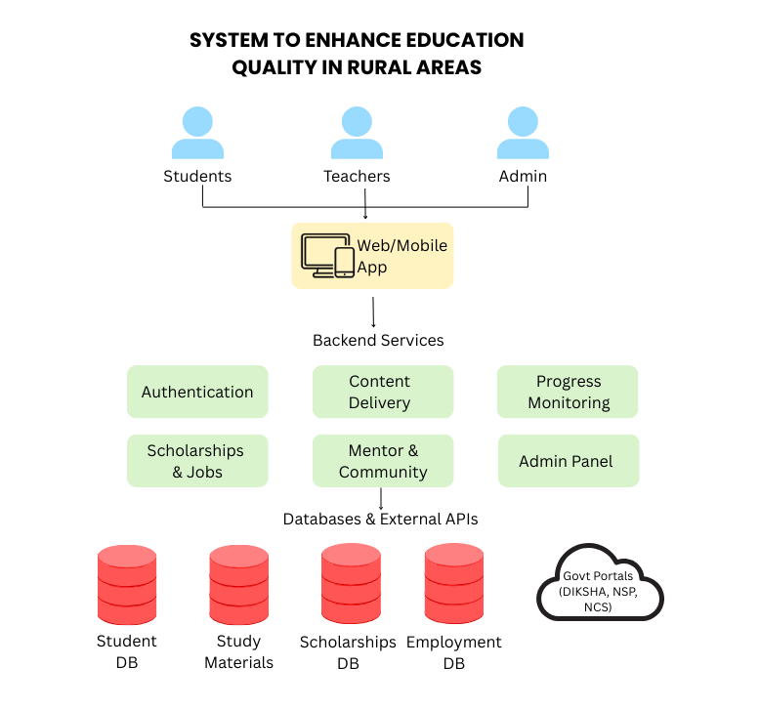
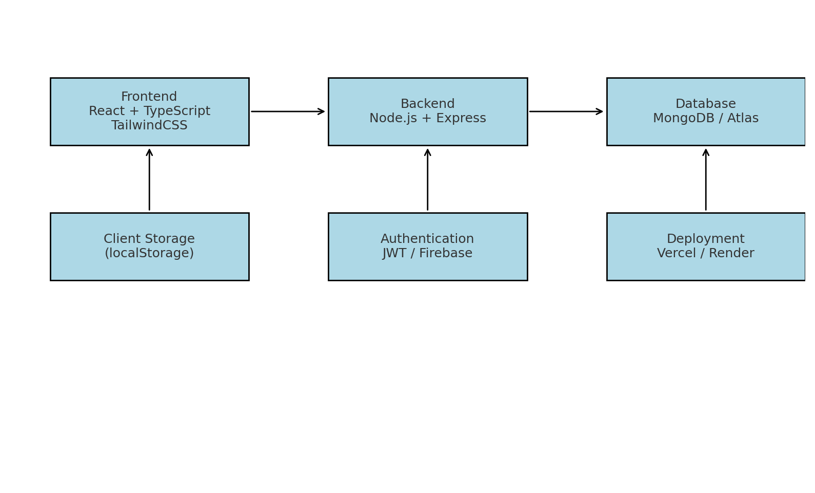
Architecture Diagram

Slide 9
Modules
Authentication & Role Management:
Handles login and session storage.
Provides role-based access for Student, Reviewer, and Admin/Committee.
Book Management Module:
Displays textbooks with details (title, author, subject, rating).
Allows searching, filtering, and browsing books.
Review & Rating Module:
Students/Reviewers submit reviews with ratings and comments.
Stores and updates aggregated book scores.
Admin/Committee Module:
Approves or rejects books.
Monitors performance and ensures quality standards.
Analytics & Reporting Module:
Uses Recharts for visual dashboards.
Provides subject-wise averages and comparison charts.
Storage Module:
Uses localStorage (demo).
Can be extended to MongoDB for persistence.

Slide 10
Algorithms
1. Authentication (bcrypt)
Purpose: Securely verify user credentials using password hashing.
Use: Protects all user accounts (students, mentors, and admins) by encrypting passwords with bcrypt, ensuring privacy and security during login and registration.
2. Role-Based Access Control (RBAC)
Purpose: Enforce data access boundaries based on user type.
Use: Defines permissions for students, mentors, and administrators—ensuring each role can only access authorized modules such as progress tracking, mentorship dashboards, or content management.
3. Admin moderation workflow (Approval queue)
Purpose: Present pending reviews/submissions and allow admins to approve/reject. Described in Admin Dashboard / Approval workflow.4. Session and Token Management
4. Sentiment analysis on textual comments
Use an NLP model (lightweight transformer or classical classifier) to classify review comments as positive/negative/neutral and extract top frequent issues (topic modeling).
Benefit: surface common problems (outdated content, poor examples) automatically.
5. Automated rubric consistency checks
Detect if reviewers assign contradictory scores (e.g., high overall score but low score on relevance) — flag inconsistent entries.

Slide 11
Algorithms
5. Recommendation engine (book suggestions)
Simple collaborative filter: recommend books that reviewers who liked Book A also rated highly.
Algorithms: item-based collaborative filtering (cosine similarity over rating vectors) or matrix factorization.
6. Security / reliability algorithms
A. Rate limiting / spam detection
Simple per-user rate limit on submissions to prevent spam.
Heuristic spam detection: very short comments, identical repeated comments, too many submissions in short time → mark for review.
B. Row-Level Security enforcement
Implemented via Supabase/Postgres RLS policies: ensures users can only edit their own reviews, admins can view all. (This is described in Security Requirements.)
7. Trend computation & dashboards
Purpose: Compute time-series (ratings over time), top-rated books, and per-criterion averages used in admin dashboards. Report references analytics module

Slide 12
Hardware and Software Requirements
Hardware:
Laptop/Server,
Internet.
Software:
Node.js & npm: Node 18.x LTS (or Node 20.x); npm bundled.
Check with: node -v and npm -v
Code editor: Visual Studio Code (recommended) or Notepad / Notepad++.
Git: for version control (git CLI).
Browser: Chrome, Firefox, Edge (latest stable) for testing.
Frame work: React(v18+) with TypeScript
Charts: Recharts

Slide 13
Git-hub Link
https://github.com/Lavanya7004/Quality-Assesment-Capstone Project

Slide 14
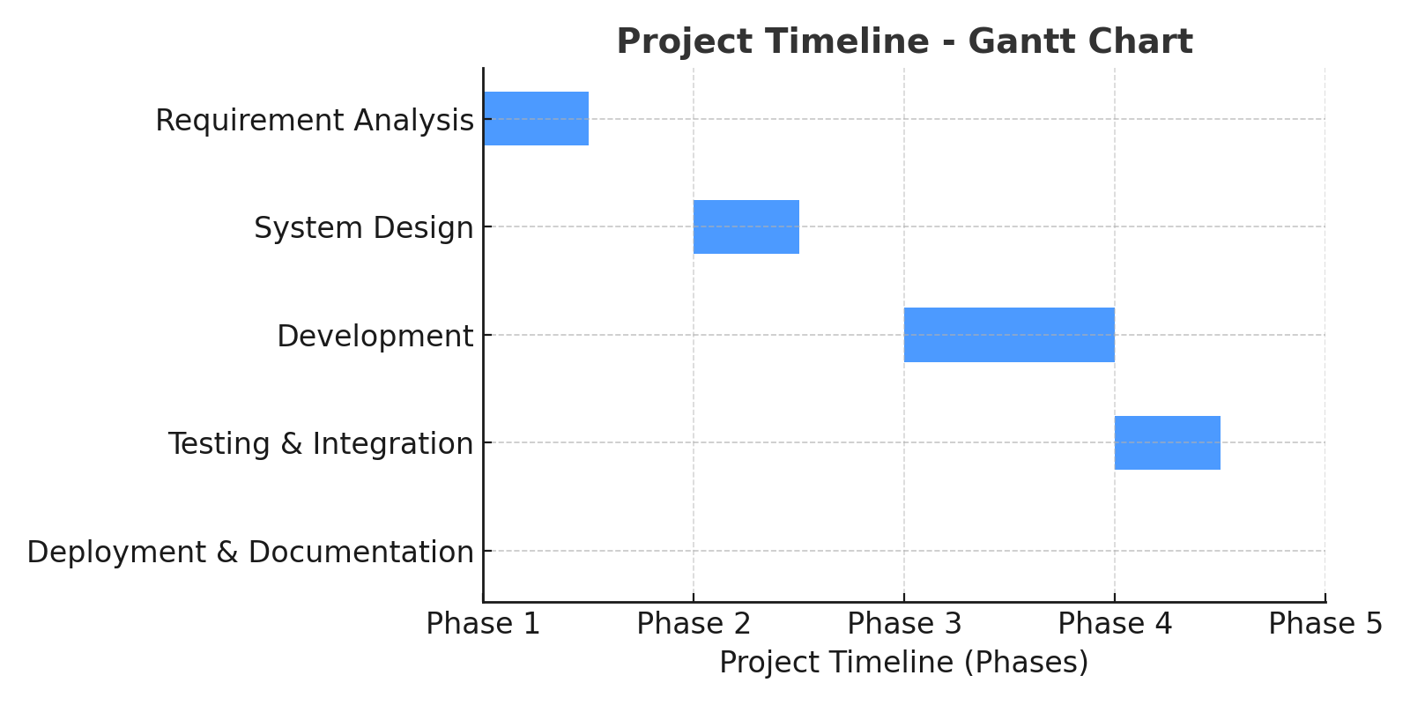
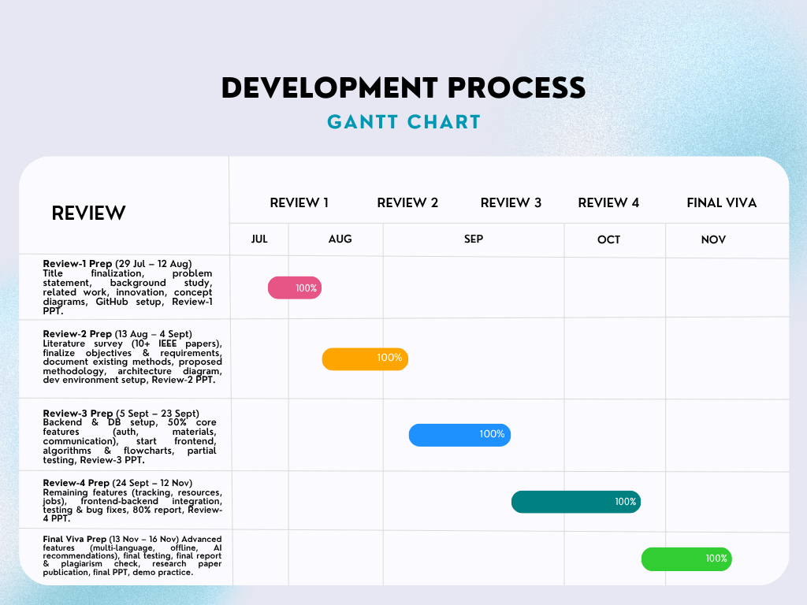
Timeline of the Project (Gantt Chart)

Slide 15
Result
The system maintains the quality of evaluation as time passes by. It achieves this by means of enforced user authentication. It is also based on well-structured rubrics throughout the entire process. The measures will have a steady level of standards in place. The main body of the modular design here is Supabase. This is quite alright when a small team of reviewers is involved. It deals with them with no actual problems. The installation is useful in bigger institutional applications as well. Scalability is effective with the various sizes of groups in practice. The web interface presented is just a simple guided interface and offers usability. Only basic training is required to complete their work through such an interface by administrators and reviewers.
User Interface Overview:
The platform has a role based system both to the reviewers and administrators. Both dashboards have easy-to use navigations and access controls. Immediate information on assessment tasks is updated in real-time. Through this approach, everything is structured without any issues.

Slide 16
References (IEEE Paper format)
[1] G. W. Cobb, “Introductory textbooks: A framework for evaluation: A comparison of 16
books,” Journal of the American Statistical Association, vol. 82, no. 397, pp. 321–339, 1987.
[2] R. A. R. Gurung and R. C. Martin, “Predicting textbook reading: The textbook assessment
and usage scale,” Teaching of Psychology, vol. 38, no. 1, pp. 22–28, 2011.
[3] C.-C. Fey and E. Matthes, “Textbook quality criteria and evaluation,” in The Palgrave
Handbook of Textbook Studies, New York: Palgrave Macmillan US, 2018, pp. 157–167.
[4] M. Mohammadi and H. Abdi, “Textbook evaluation: A case study,” Procedia - Social and
Behavioral Sciences, vol. 98, pp. 1148–1155, 2014.
[5] K. Mahmood, “Conformity to quality characteristics of textbooks: The illusion of textbook
evaluation in Pakistan,” Journal of Research and Reflections in Education, vol. 5, no. 2, pp.
170–190, 2011.
[6] A. Woodward, D. L. Elliot, and K. C. Nagel, Textbooks in School and Society: An
Annotated Bibliography & Guide to Research, New York: Routledge, 2013.

Slide 17
References (IEEE Paper format)(contd...)
[7] I. Ivić, S. Antić, and A. Pešikan, eds., Textbook Quality: A Guide to Textbook Standards,
vol. 2, Göttingen: V&R unipress GmbH, 2013.
[8] O. Yasar, “A comparative analysis of assessment and evaluation exercises included in
geography textbooks written according to the 2005 secondary education geography
curriculum and textbooks of the former curriculum in Turkey,” International Journal of
Progressive Education, vol. 5, no. 1, pp. 45–68, 2009.
[9] P. Race, The Lecturer’s Toolkit: A Practical Guide to Assessment, Learning and Teaching,
London: Routledge, 2019.
[10] J. N. Giger and L. Haddad, Transcultural Nursing: Assessment and Intervention, Elsevier
Health Sciences, 2020.

Slide 18


